Slide 1
Marks & channels

Slide 2
How can I visually represent two numbers
e.g., 4 and 8

Slide 3
Marks & channels
Marks: represent items or links
Channels: change appearance based on attribute
Channel = visual variable

Slide 4
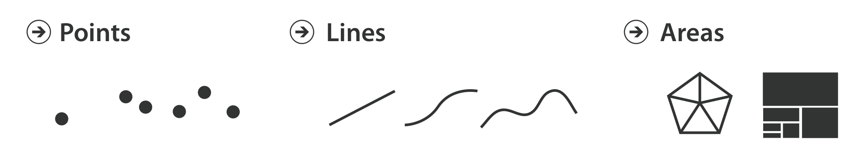
Marks for items
Basic geometric elements
0D 1D 2D
3D mark: Volume, but rarely used

Slide 5
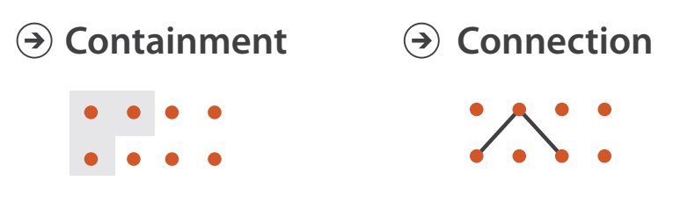
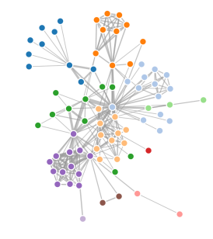
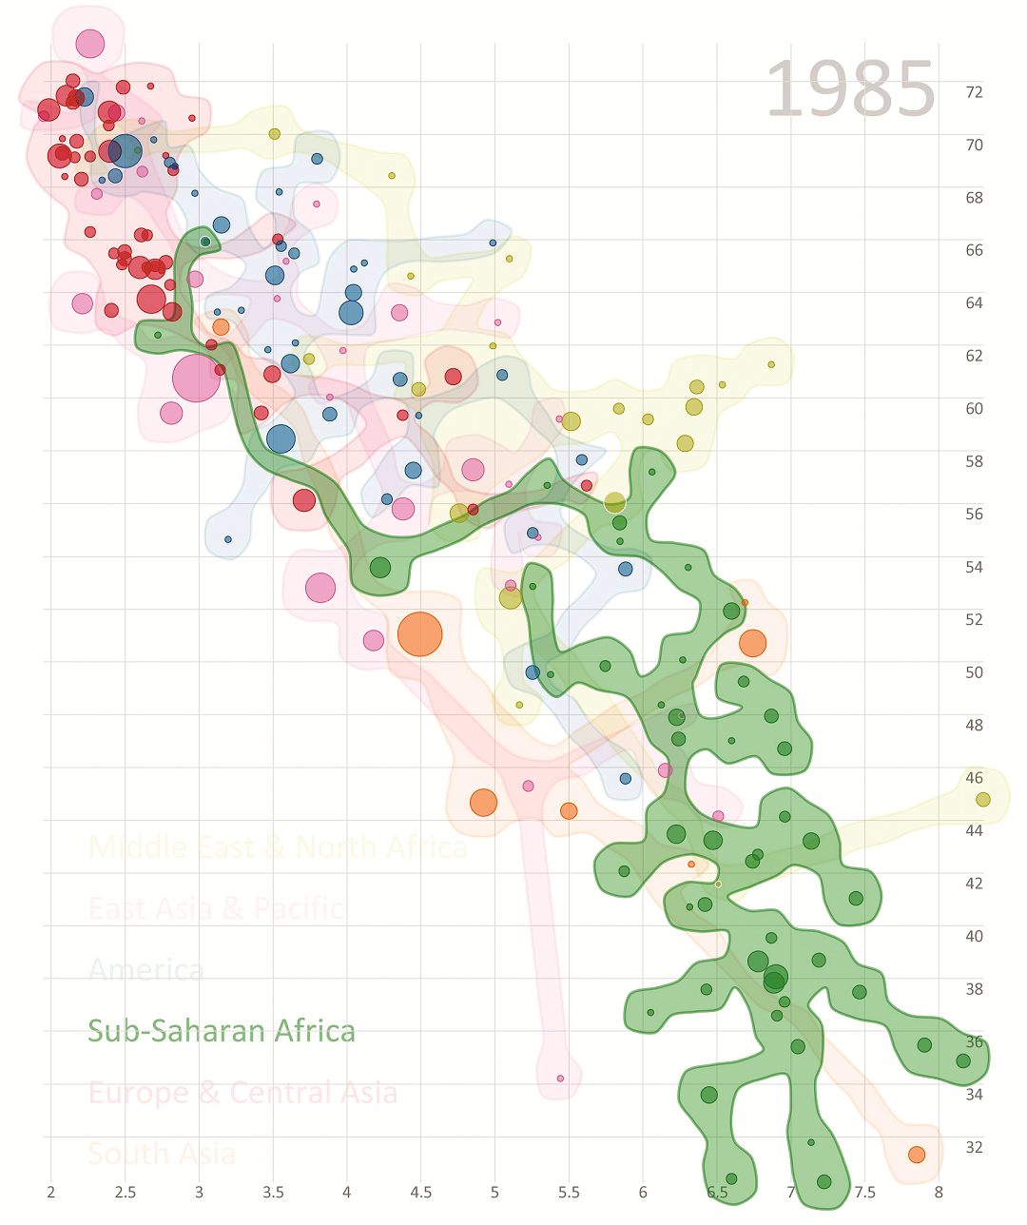
Marks for links

Slide 6
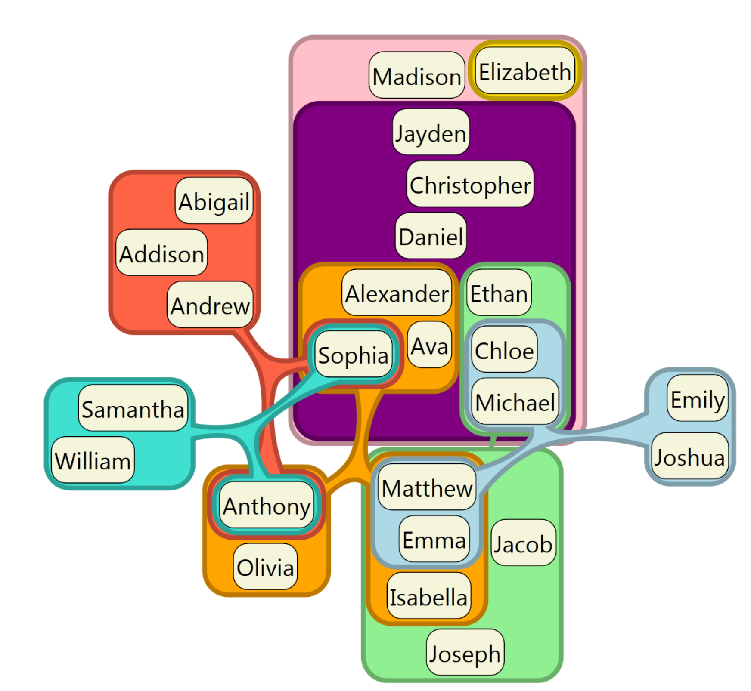
Nested containment

Slide 7
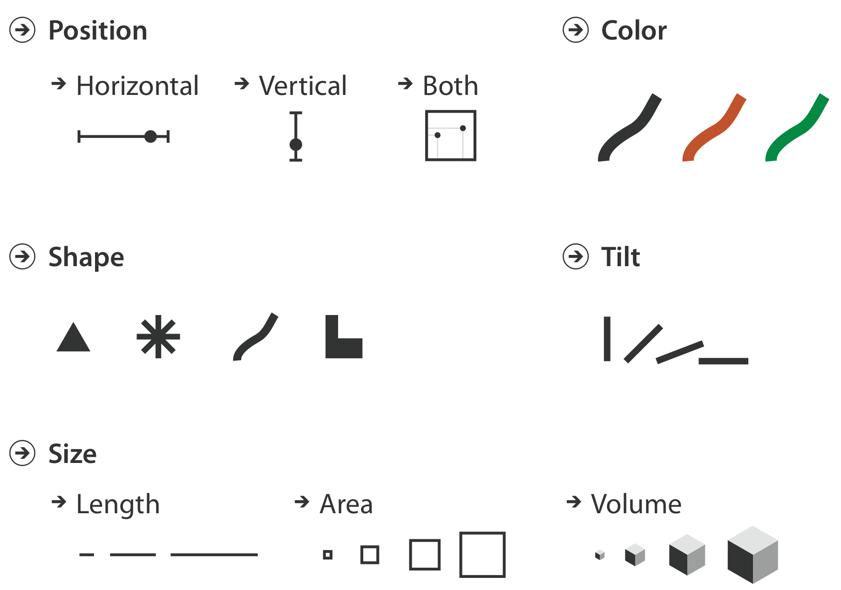
channels
Change appearance proportional to or based on attributes

Slide 8
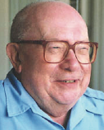
Jacques bertin
French cartographer
who makes or draws maps
Theoretical principles for visual encodings

Slide 9
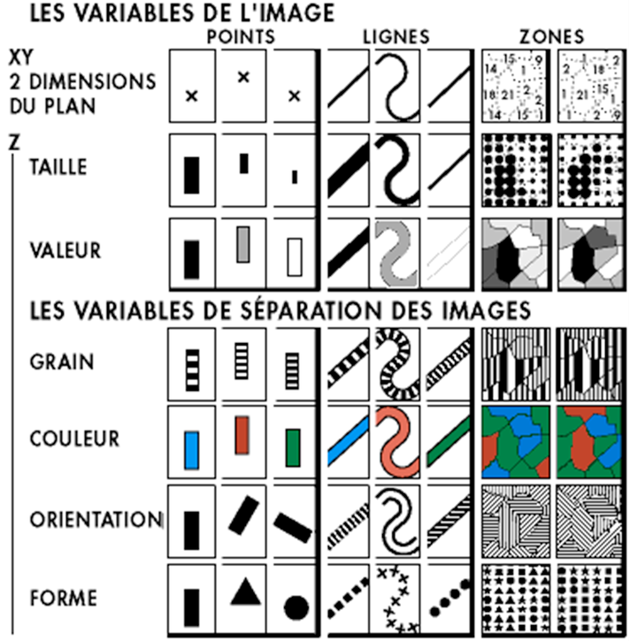
Bertin’s visual variables
Marks: Points Lines Areas
Variables of image
Position
Size
(gray)Value
Texture
Color
Orientation
Shape
Variable to distinguish images
Semiology of Graphics [J. Bertin, 67]

Slide 10
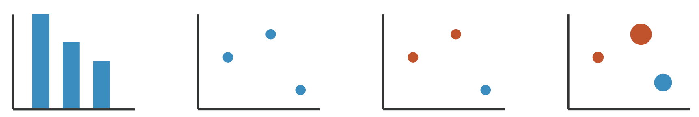
Using marks and channels
Mark: Line
Channel:
Length, Position
1 quantitative attribute
1 categorical attribute
Mark: Point
Channel: Position
1 quantitative attr.
Adding Hue
+1 categorical attr.
Adding Size
+1 quantitative attr.

Slide 11
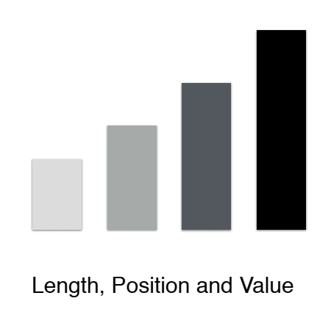
Redundant encoding

Slide 12
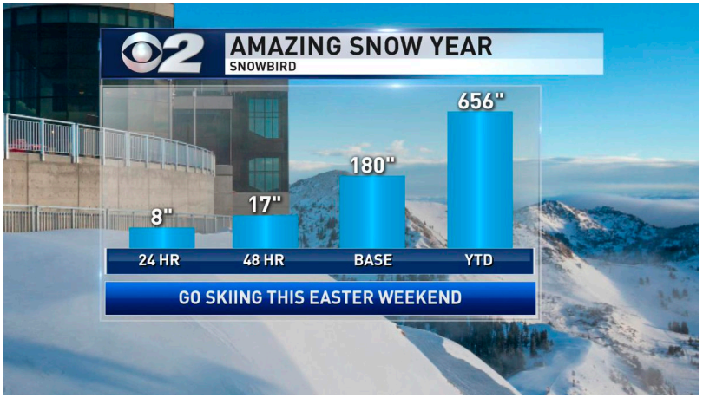
Good bar chart?
Rule: Use channel proportional to data!
https://twitter.com/ChaseThomason/status/1118478036507164672?s=19

Slide 13
Types of channels
Magnitude channels
How much? Which rank?
Position
Length
Saturation …
Ordinal & Quantitative data
Identity channels
What?
Shape
Color (hue)
Spatial region...
Categorical Data

Slide 14
Principles of expressiveness and effectiveness
Expressiveness principle
The visual encoding should express all of, and only, the information in the dataset attributes
Effectiveness principle:
The importance of attribute should match the salience of the channel
Means:
The most important attributes should be encoded with the most effective channels in order to be most noticeable
Then the following important attributes match with less effective channels

Slide 15
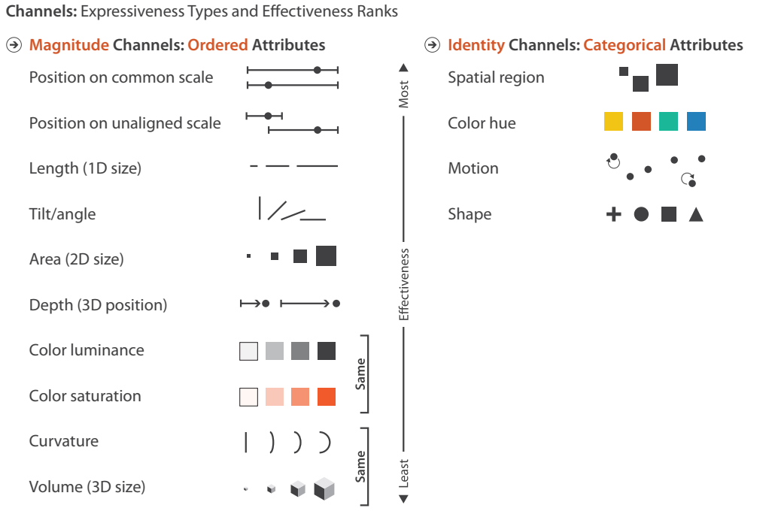
Rank of Channels
Notes:
Spatial region: bar charts

Slide 16
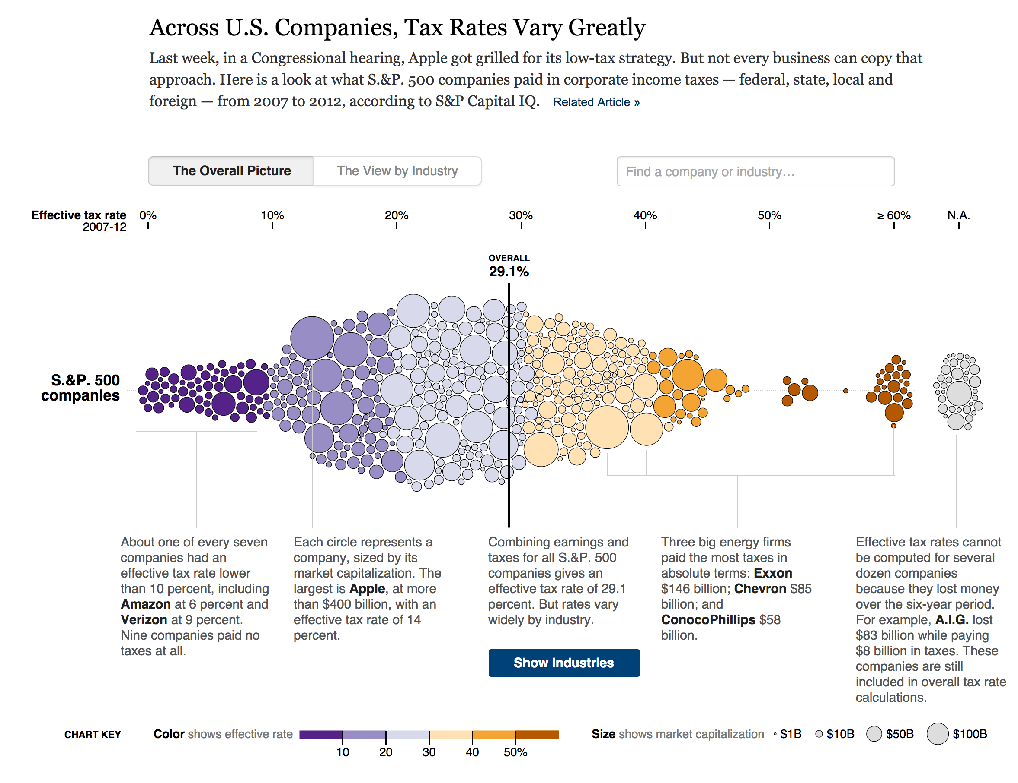
What visual variables are used?
http://www.nytimes.com/interactive/2013/05/25/sunday-review/corporate-taxes.html
Notes:
Color
Position
Size

Slide 17



Characteristics of channels
Selective
Is a mark distinct from other marks?
Can we make out the difference between two marks?
Associative
Does it support grouping?
Quantitative (Magnitude vs identity channels)
Can we quantify the difference between two marks?

Slide 18
Characteristics of channels
Order (Magnitude vs Identity)
Can we see a change in order?
Length
How many unique marks can we make?

Slide 19

position
Strongest visual variables
Suitable for all data types
Problems:
Sometimes not available (spatial data, map)
Cluttering (many items overlapped)
Selective: Yes
Associative: Yes
Quantitative:Yes
Order: Yes
Length: Fairly big
(options)
→ Good channel
Notes:
Length number of options

Slide 20
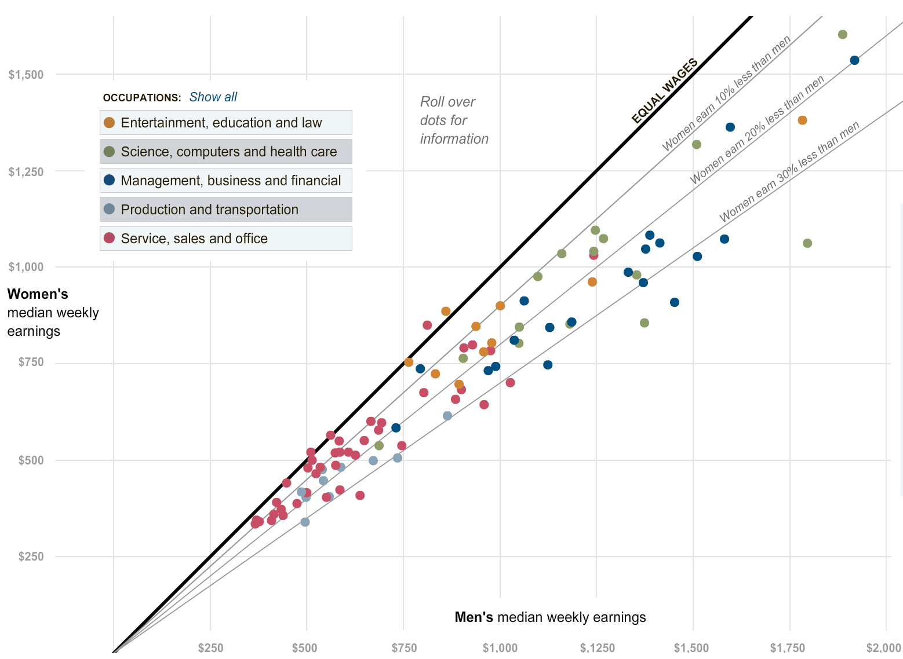
Example: scatterplot

Slide 21
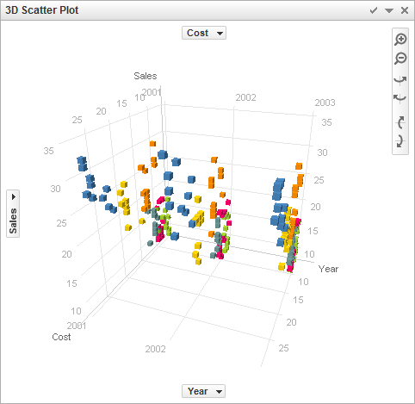
Position in 3D? Not so good

Slide 22

Length & size
Good for 1D, OK for 2D, Bad for 3D
Easy to see which one is bigger
Aligned bars use position redundantly
1D length:
Selective: yes
Associative: yes
Quantitative: yes
Order: yes
Length: yes
Notes:
Aligned vs non-aligned

Slide 23
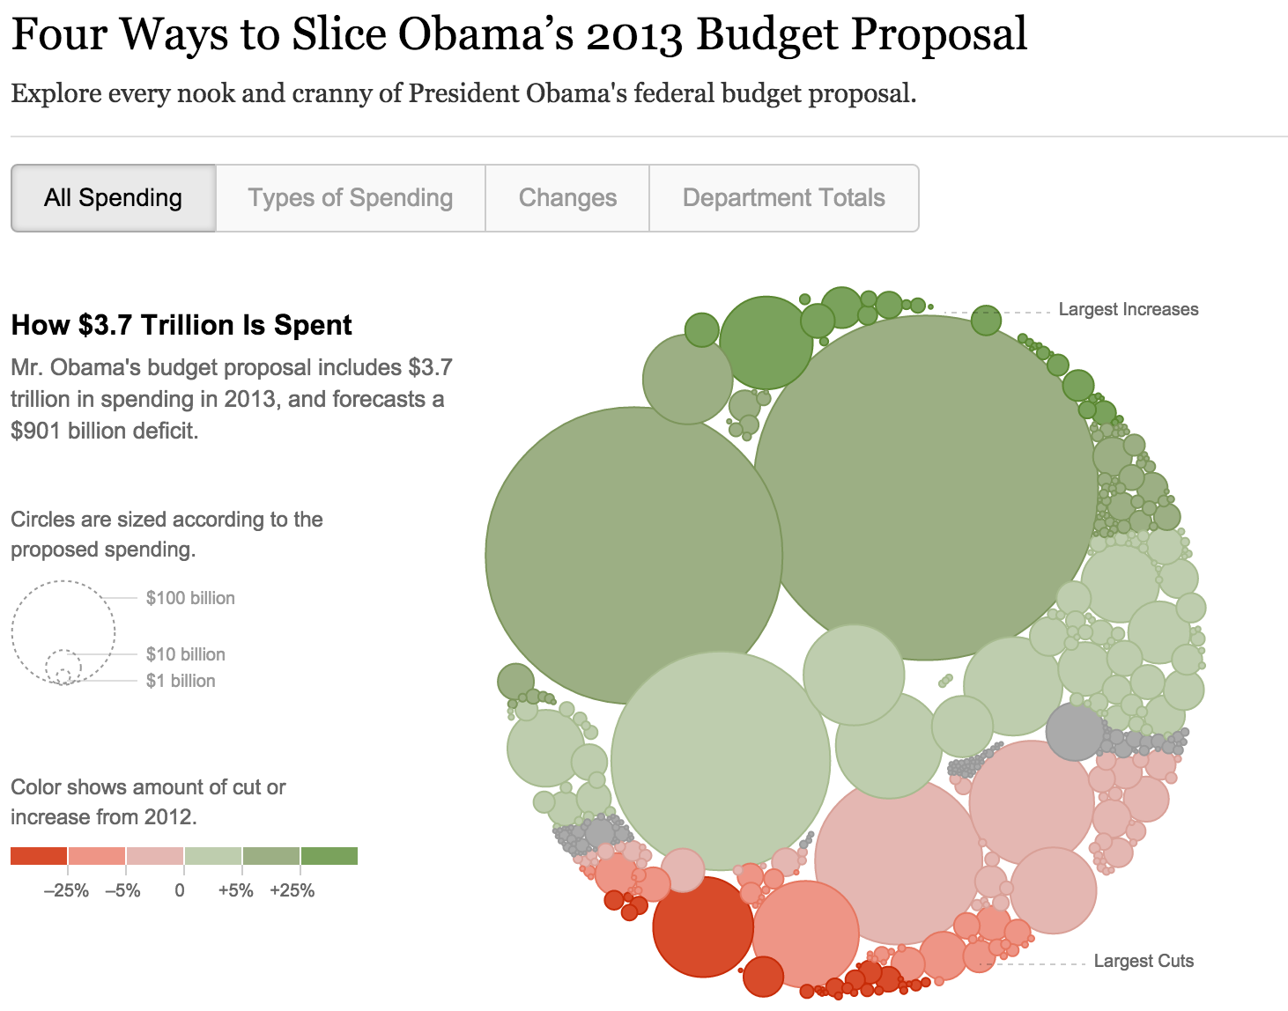
Example 2d Size: bubbles
Notes:
Can notice to largest bubbles

Slide 24

Value/luminance/saturation
OK for quantitative data when length & size are used
Not very many shades recognizable
Selective: yes
Associative: yes
Quantitative: somewhat
Order: yes
Length: limited (around 7 – 8)

Slide 25
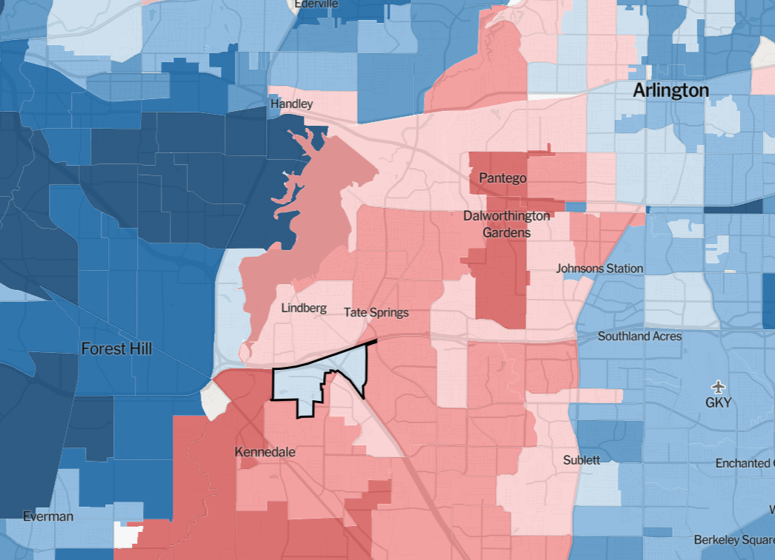
Example: Diverging value-scale
https://www.nytimes.com/interactive/2018/upshot/election-2016-voting-precinct-maps.html#11.08/32.700/-97.197/115304
Notes:
Disproportional effect

Slide 26

Color
Good for qualitative data (identity channel)
Limited number of classes/length (7-10)
Do not work for quantitative data
Lots of pitfalls !
Good practice: minimize use of color for encoding data
Selective: yes
Associative: yes
Quantitative: no
Order: no
Length: limited

Slide 27
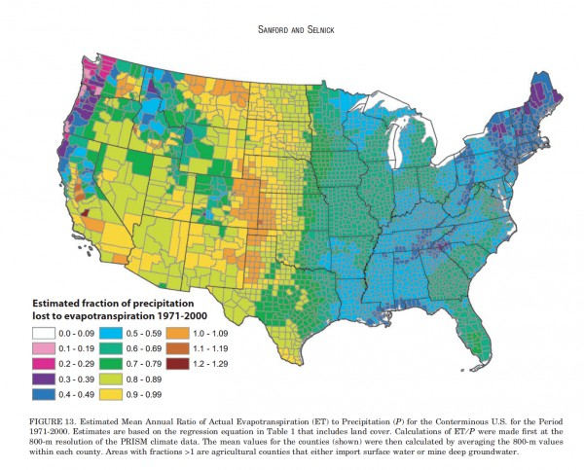
Color: bad example

Slide 28
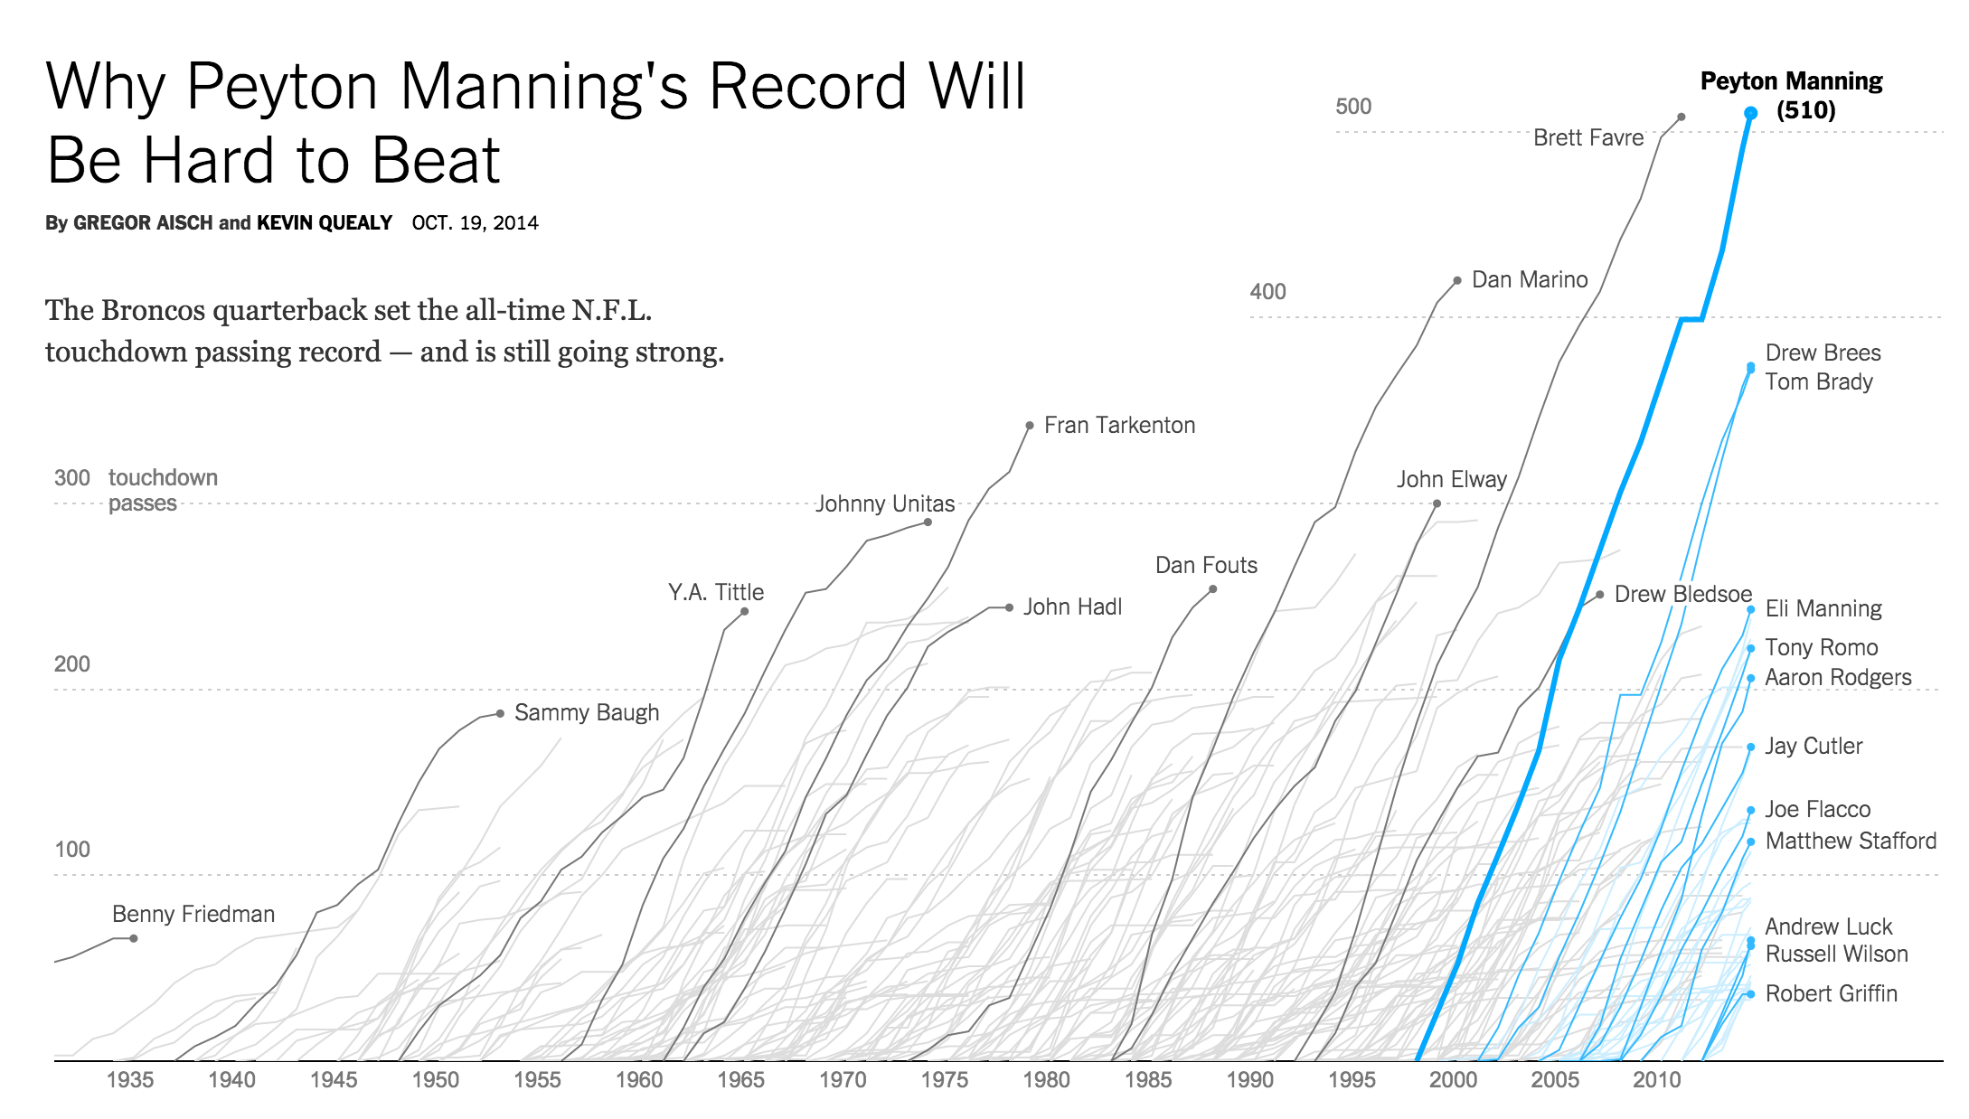
Color: good example

Slide 29
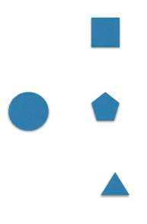
shape
Great to recognize many classes
No grouping, ordering
Selective: yes
Associative: limited
Quantitative: no
Order: no
Length: vast

Slide 30
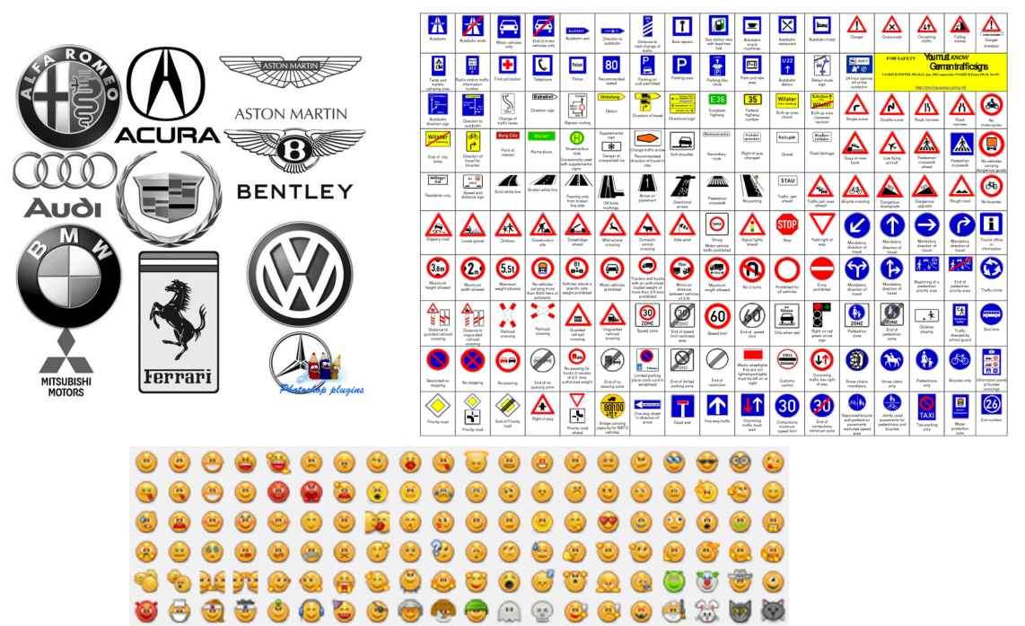

Slide 31
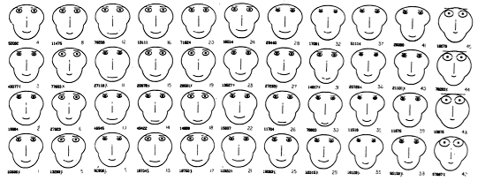
Idea: use facial parameters to map quantitative data
Does it work? Not really
Critique: https://eagereyes.org/criticism/chernoff-faces
Notes:
Human is good facial expression

Slide 32
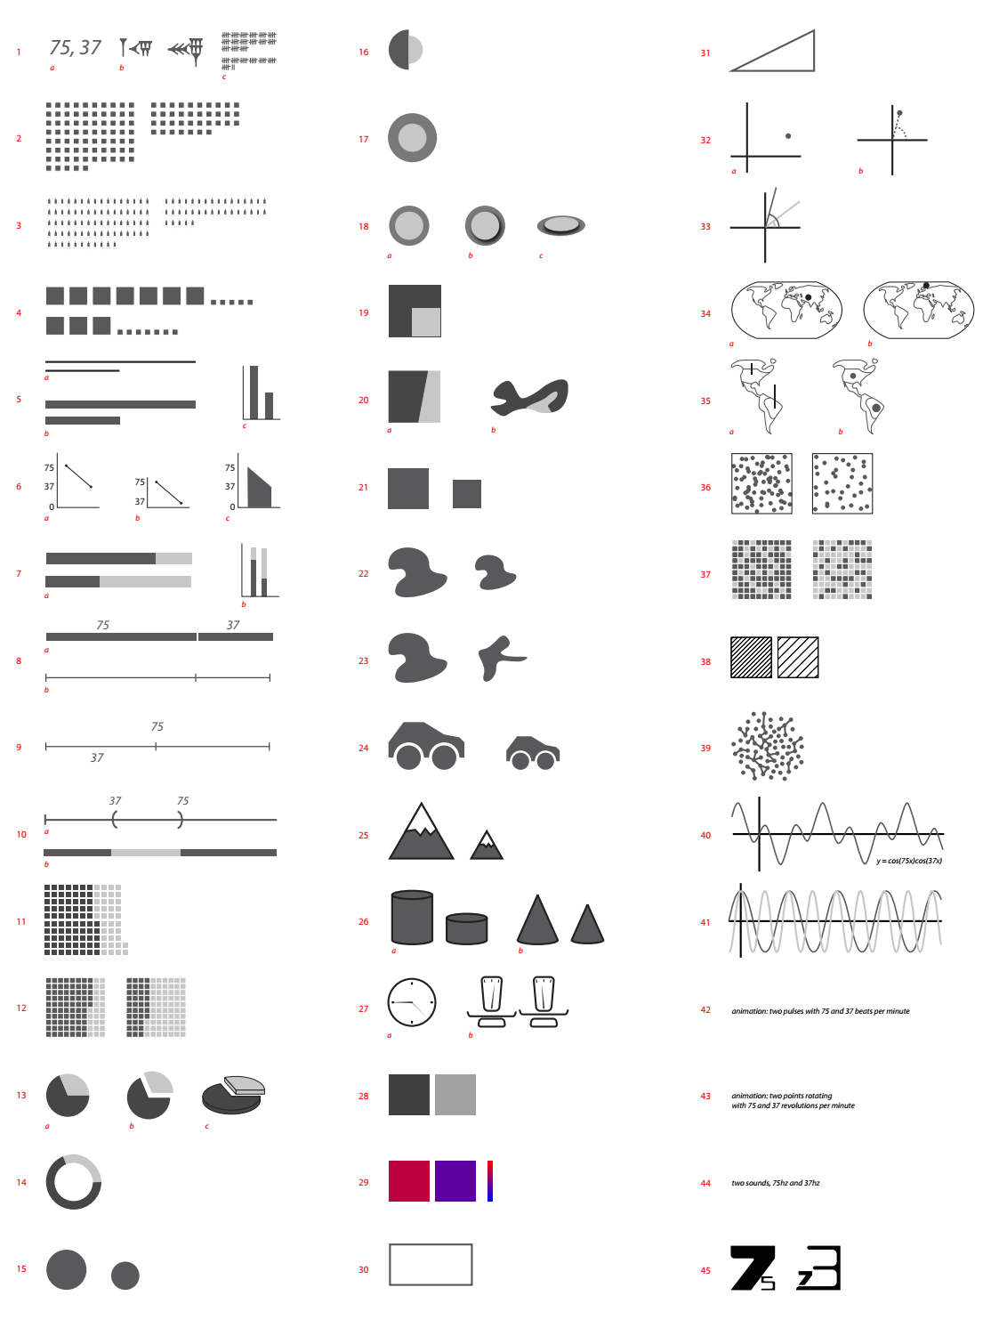
More channels
https://en.rockcontent.com/blog/2012/07/27/45-ways-to-communicate-two-quantities/

Slide 33
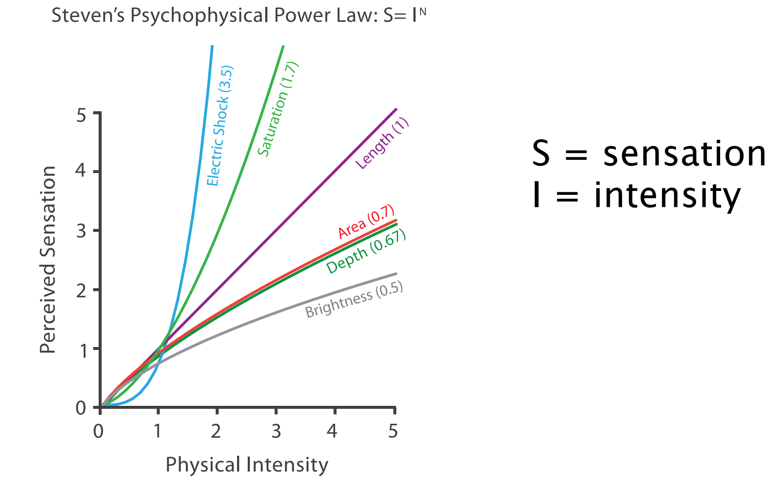
Accuracy of channels

Slide 34
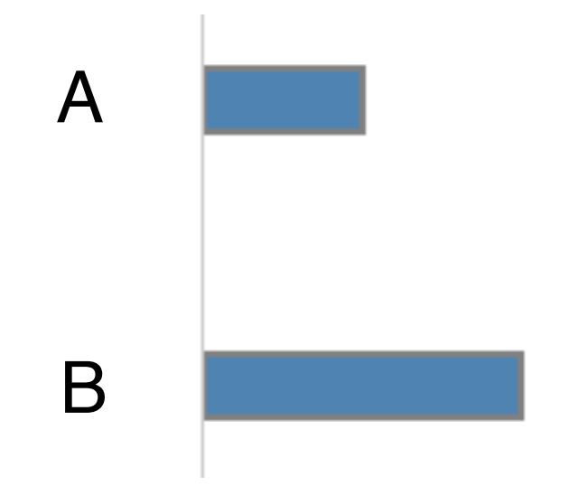
How much longer?
2x

Slide 35
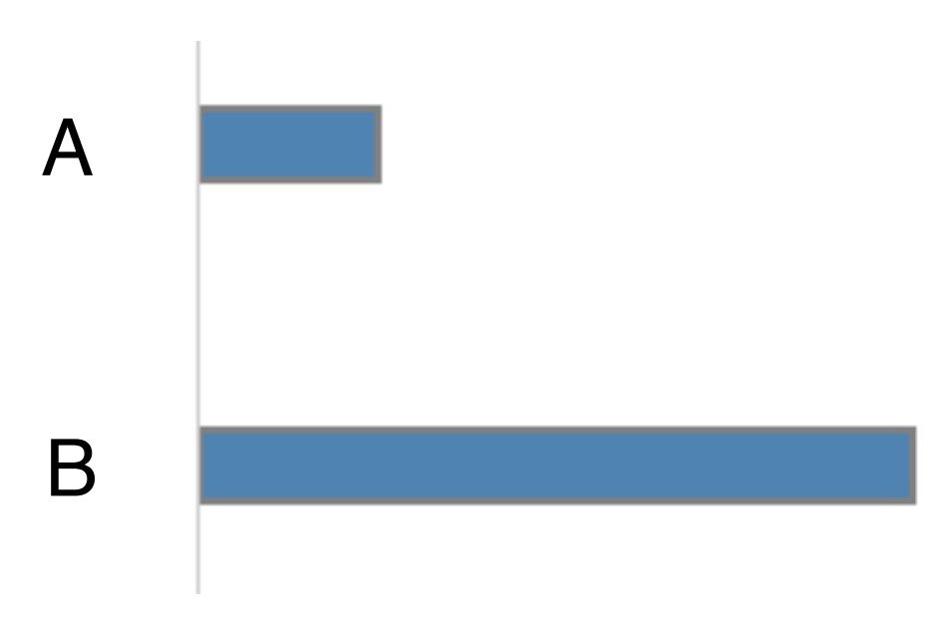
How much longer
4x

Slide 36
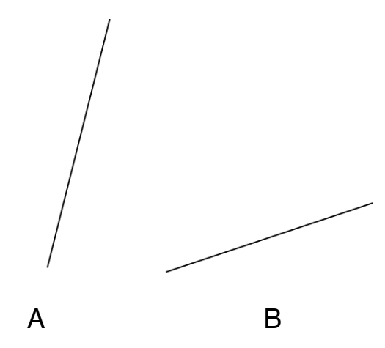
How much steeper?
~4x

Slide 37
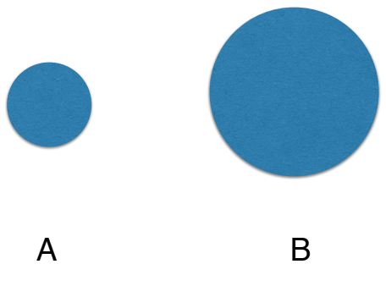
How much larger?
2x diameter
4x area

Slide 38
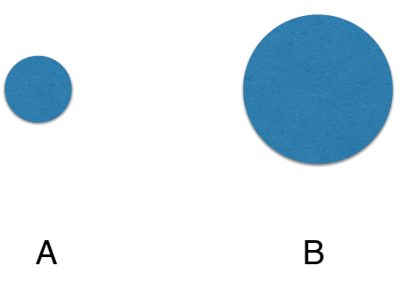
How much larger?
5x

Slide 39
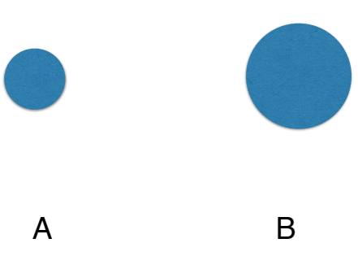
How much larger (area)?
3x

Slide 40
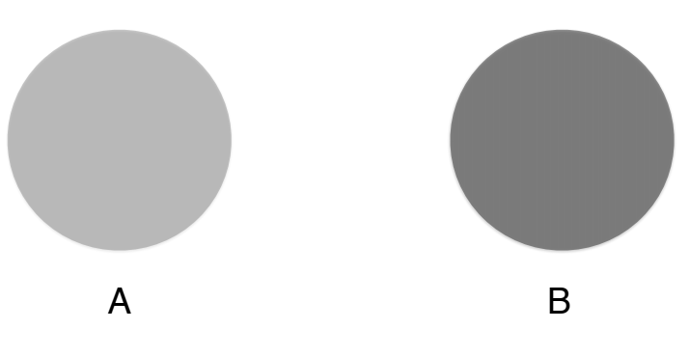
How much darker?
2x

Slide 41
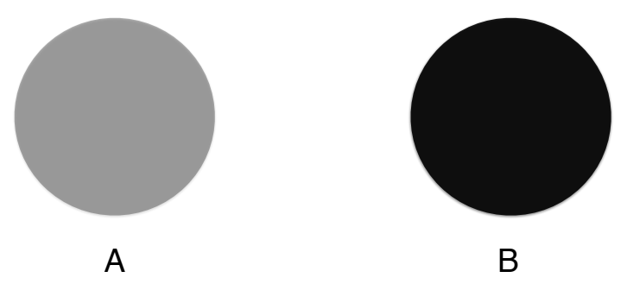
How much darker?
3x

Slide 42
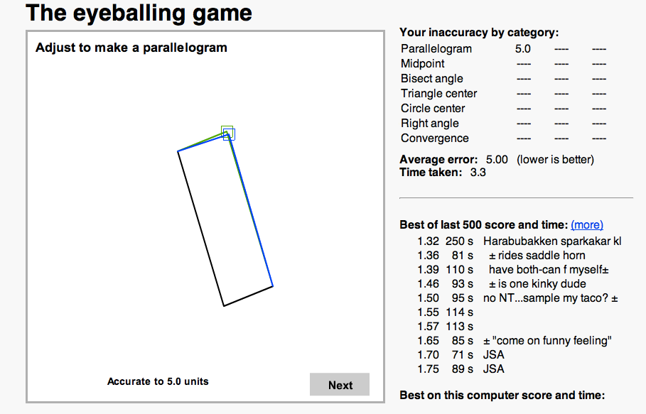
Position, length & angle
https://woodgears.ca/eyeball/index.html

Slide 43
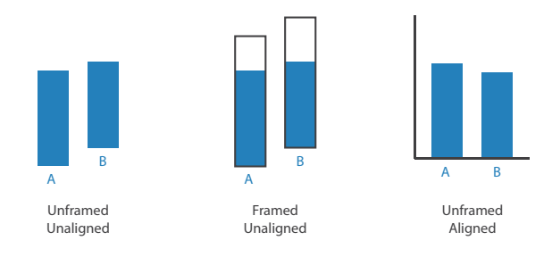
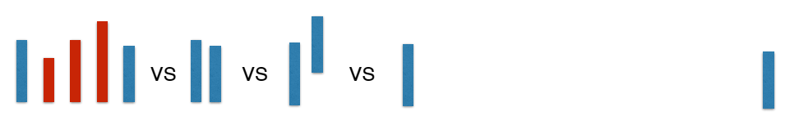
Other factors affecting accuracy
Alignment
Distractors
Distance
Common scale
Notes:
Frame make it is easy to compare

Slide 44
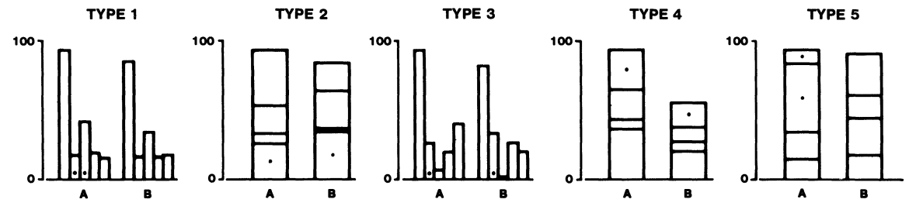
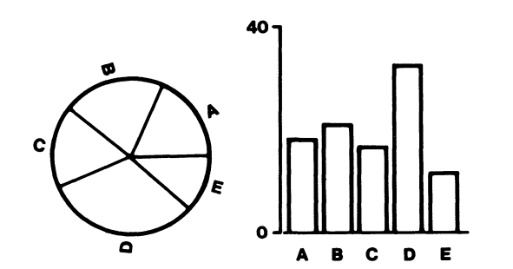
Research by Cleveland 1984

Slide 45
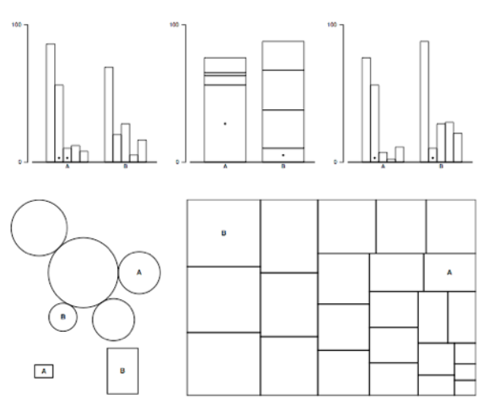
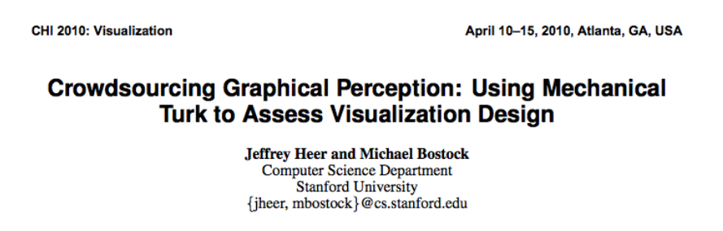
Heer & Bostock, 2010
https://www.mturk.com/worker
Notes:
Discuss pros & cons of crowdsourcing perception
On amazon platform

Slide 46
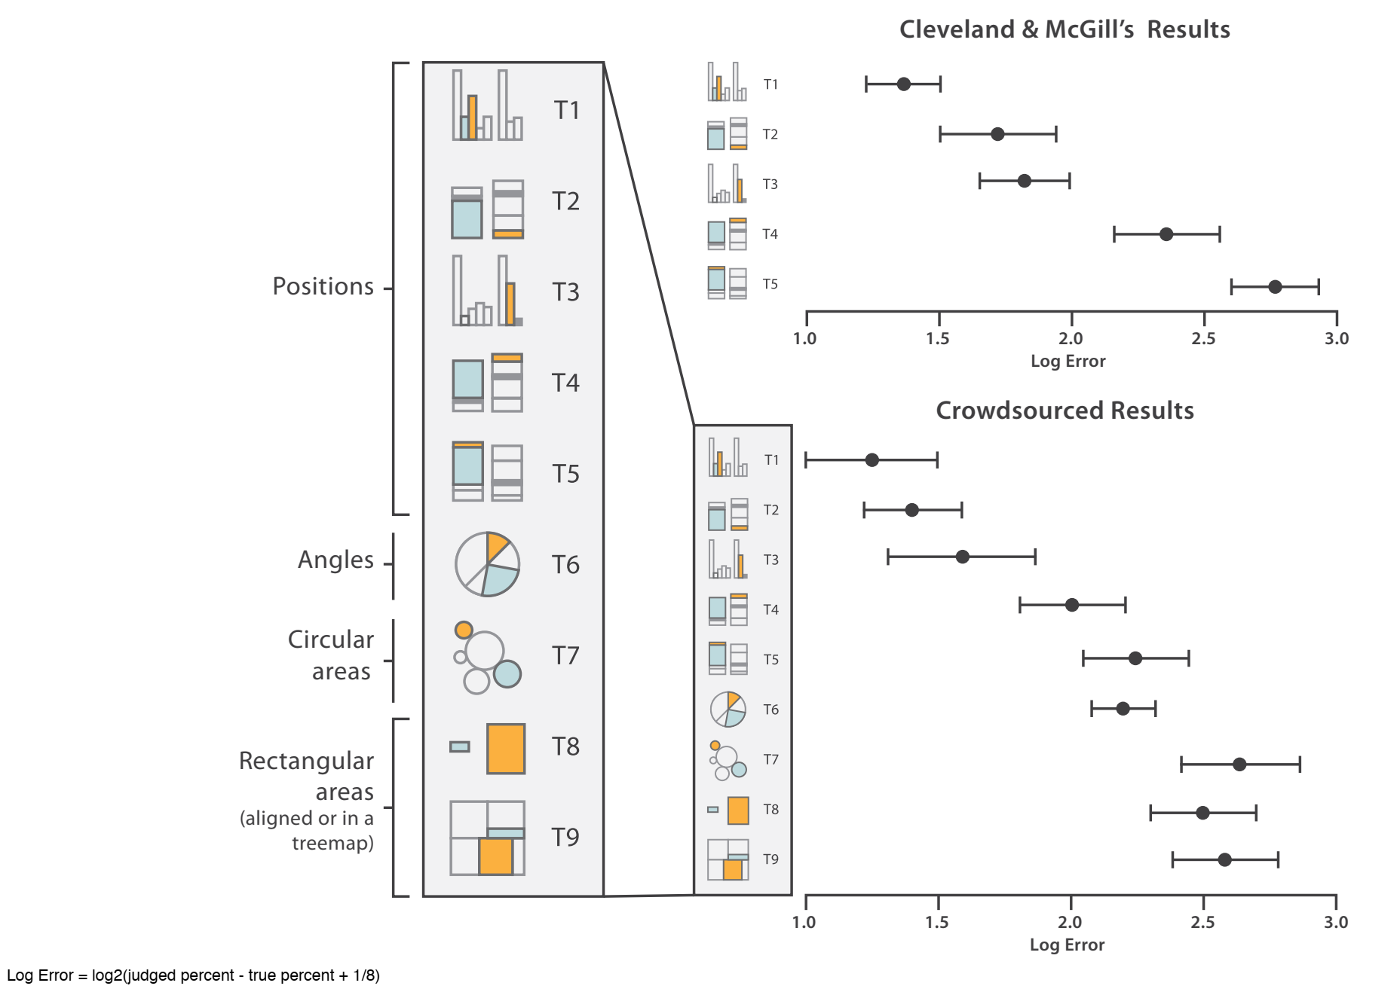

Slide 47
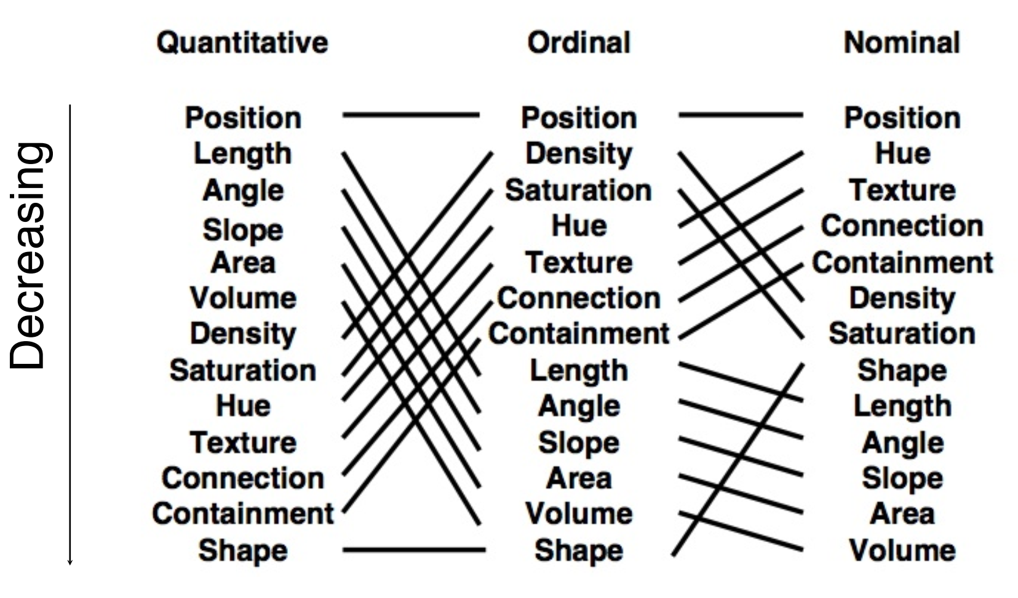
Jock Mackinlay, 1986
[Mackinlay, Automating the Design of Graphical Presentations of Relational Information, 1986]

Slide 48
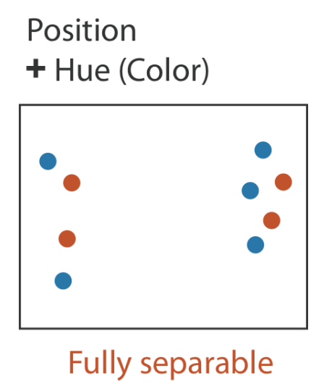
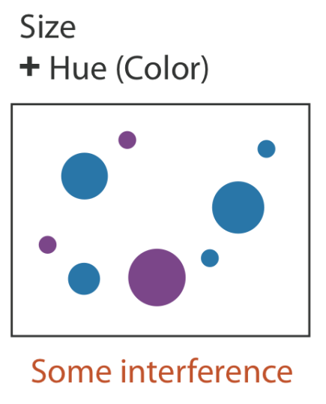
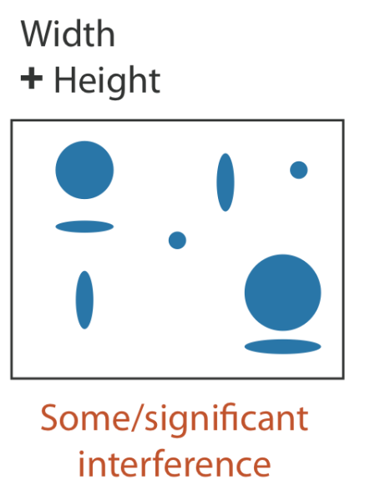
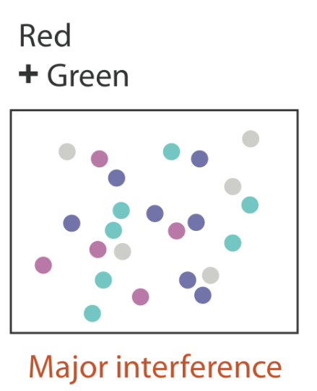
Separability of attributes
Can we combine multiple visual variables?
T. Munzner, Visualization Analysis and Design, 2014

